Slide 1
COMPUTER ORGANIZATION & ARCHITECTURE

Slide 2
Unit-3
Basic Computer Organization & Design

Slide 3
Basic Computer Organization & Design
1. Instruction Codes
2. Computer Registers
3. Computer Instructions
4. Timing and Control
5. Instruction Cycle
6. Memory-Reference Instructions
7. Input-Output and Interrupt
8. Complete Computer Description
9. Design of Basic Computer
10. Design of Accumulator Logic

Slide 4
Instruction Codes
Instruction Codes:
* The organization of the computer is defined by its internal registers, the timing and control structure, and the set of instructions that it uses.
* Internal organization of a computer is defined by the sequence of micro-operations it performs on data stored in its registers.
Computer can be instructed about the specific sequence of operations it must perform.
User controls this process by means of a Program.
* Program: set of instructions that specify the operations, operands, and the sequence by which processing has to occur.
* Instruction: a binary code that specifies a sequence of micro-operations for the computer.

Slide 5
The computer reads each instruction from memory and places it in a control register. The control then interprets the binary code of the instruction and proceeds to execute it by issuing a sequence of micro-operations. – Instruction Cycle
Instruction Code: group of bits that instruct the computer to perform specific operation.
Instruction code is usually divided into two parts: Opcode and address(operand)

Slide 6

Instruction Codes
The Operation code (Opcode) field determines the process that needs to be performed
The Address field contains the operand's location, i.e., register or memory location.
The Mode field specifies
how the operand locates
15
14
12
11
0
Instruction Format

Slide 7
Operation Code (opcode):
Group of bits that define the operation
Eg: add, subtract, multiply, shift, complement.
No. of bits required for opcode depends on no. of operations available in computer.
n bit opcode >= 2 n (or less) operations
Address (operand):
Specifies the location of operands (registers or memory words)
Memory words are specified by their address
Registers are specified by their k-bit binary code
k-bit address >= 2 k registers

Slide 8
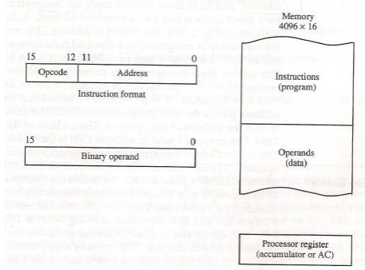
Stored Program Organization:
The ability to store and execute instructions is the most important property of a general-purpose computer. That type of stored program concept is called stored program organization.
The simplest way to organize a computer is to have one processor register and an instruction code format with two parts. The first part specifies the operation to be performed and the second specifies an address.

Slide 9
* Instructions are stored in one section of memory and data in another.
For a memory unit with 4096 words we need 12 bits to specify an address since 212 = 4096.
If we store each instruction code in one 16-bit memory word, we have available four bits for the operation code (abbreviated opcode) to specify one out of 16 possible operations, and 12 bits to specify the address of an operand.
Accumulator (AC):
Computers that have a single-processor register usually assign to it the name accumulator and label it AC.
The operation is performed with the memory operand and the content of AC.

Slide 10
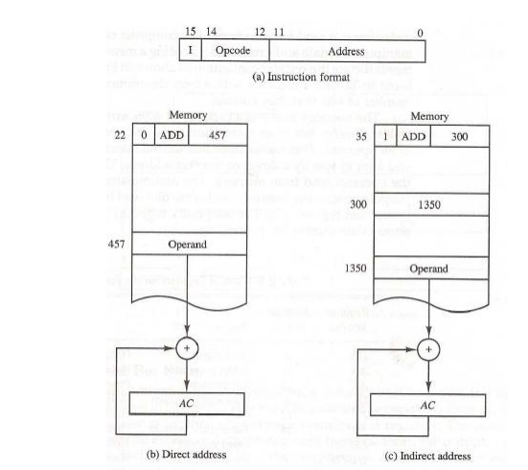
Addressing of Operand
Addressing of Operand:

Slide 11
Computer Registers
Computer Registers:
What is the need for computer registers?
The need of the registers in computer for Instruction sequencing needs a counter to calculate the address of the next instruction after execution of the current instruction is completed (PC).
Necessary to provide a register in the control unit for storing the instruction code after it is read from memory (IR).
Needs processor registers for manipulating data (AC and TR) and a register for holding a memory address (AR).

Slide 12
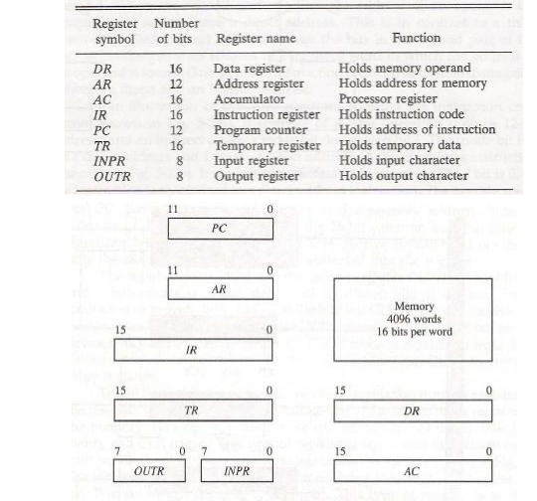

Slide 13
COMMON BUS SYSTEM
S2
S1
Bus
S₂ S₁ S₀ Register
Common Bus System
S0
Memory unit
7
0 0 0 x
0 0 1 AR
0 1 0 PC
0 1 1 DR
1 0 0 AC
1 0 1 IR
1 1 0 TR
1 1 1 Memory
4096 x 16
Address
Write
Read
AR
1
LD INR CLR
PC
2
LD INR CLR
DR
3
LD INR CLR
E
ALU
AC
4
LD INR CLR
INPR
IR
5
LD
TR
6
LD INR CLR
OUTR
Clock
LD
16-bit common bus

Slide 14
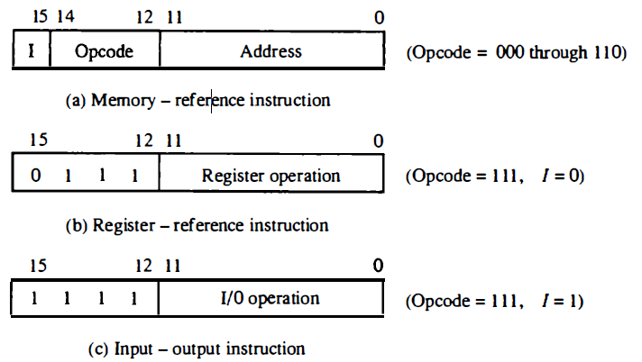
Instructions are of three types
Register reference instructions
Memory reference instructions
IO reference instruction
12 bits to specify an address
Addressing mode
I = 0 : direct addressing
I = 1 : indirect addressing

Slide 15
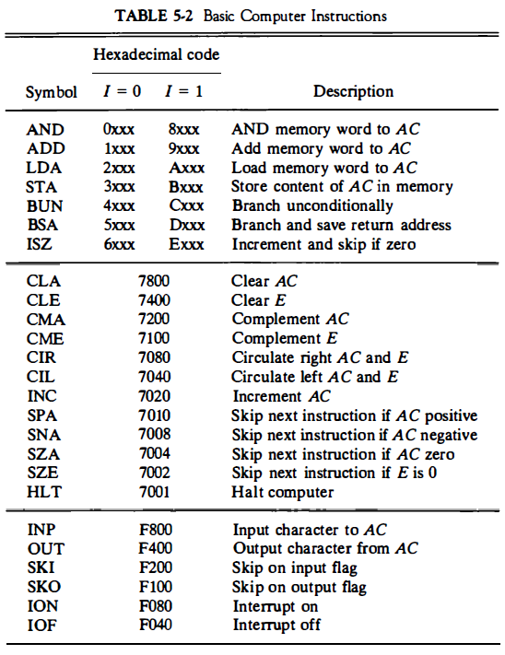

Slide 16
Timing and Control
Timing and Control
The timing for all registers in the basic computer is controlled by a master clock generator.
The clock pulses are applied to all flip-flops and registers in the system, including the flip-flops and registers in the control unit.
The clock pulses do not change the state of a register unless the register is enabled by a control signal.
The control signals are generated in the control unit and provide control inputs for the multiplexers in the common bus, control inputs in processor registers, and micro operations for the accumulator.
There are two major types of control organization: o Hardwired control o Micro programmed control

Slide 17
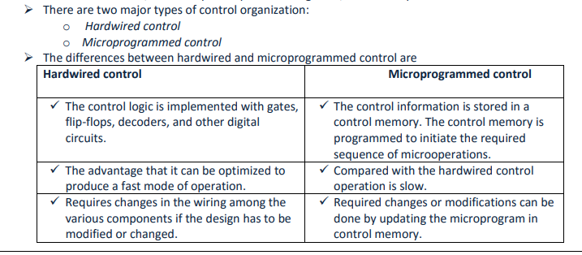

Slide 18
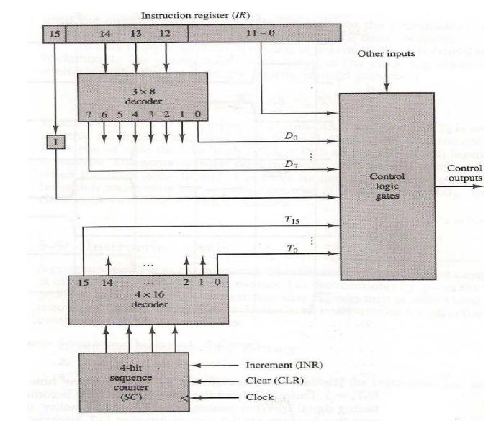

Slide 19
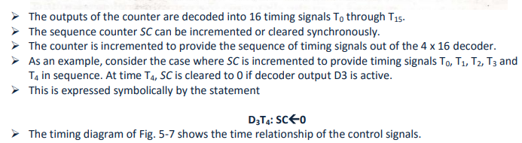

Slide 20
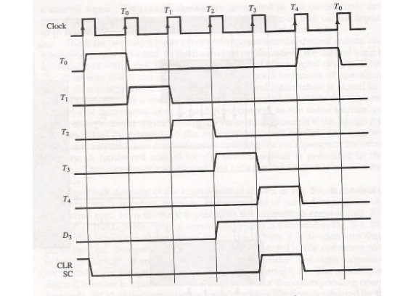

Slide 21
Instruction Cycle
Instruction Cycle
Every program is a collection of instructions
Each instruction of the program is executed using instruction cycle.
In Basic Computer, a machine instruction is executed in the following cycle:
Fetch an instruction from memory (Retrieving Instruction from the memory)
Decode the instruction (which operation the corresponding instruction will perform)
Read the effective address from memory if the instruction has an indirect address
Execute the instruction
Fetch Next
Instruction
Execute
Instruction
HALT
START

Slide 22
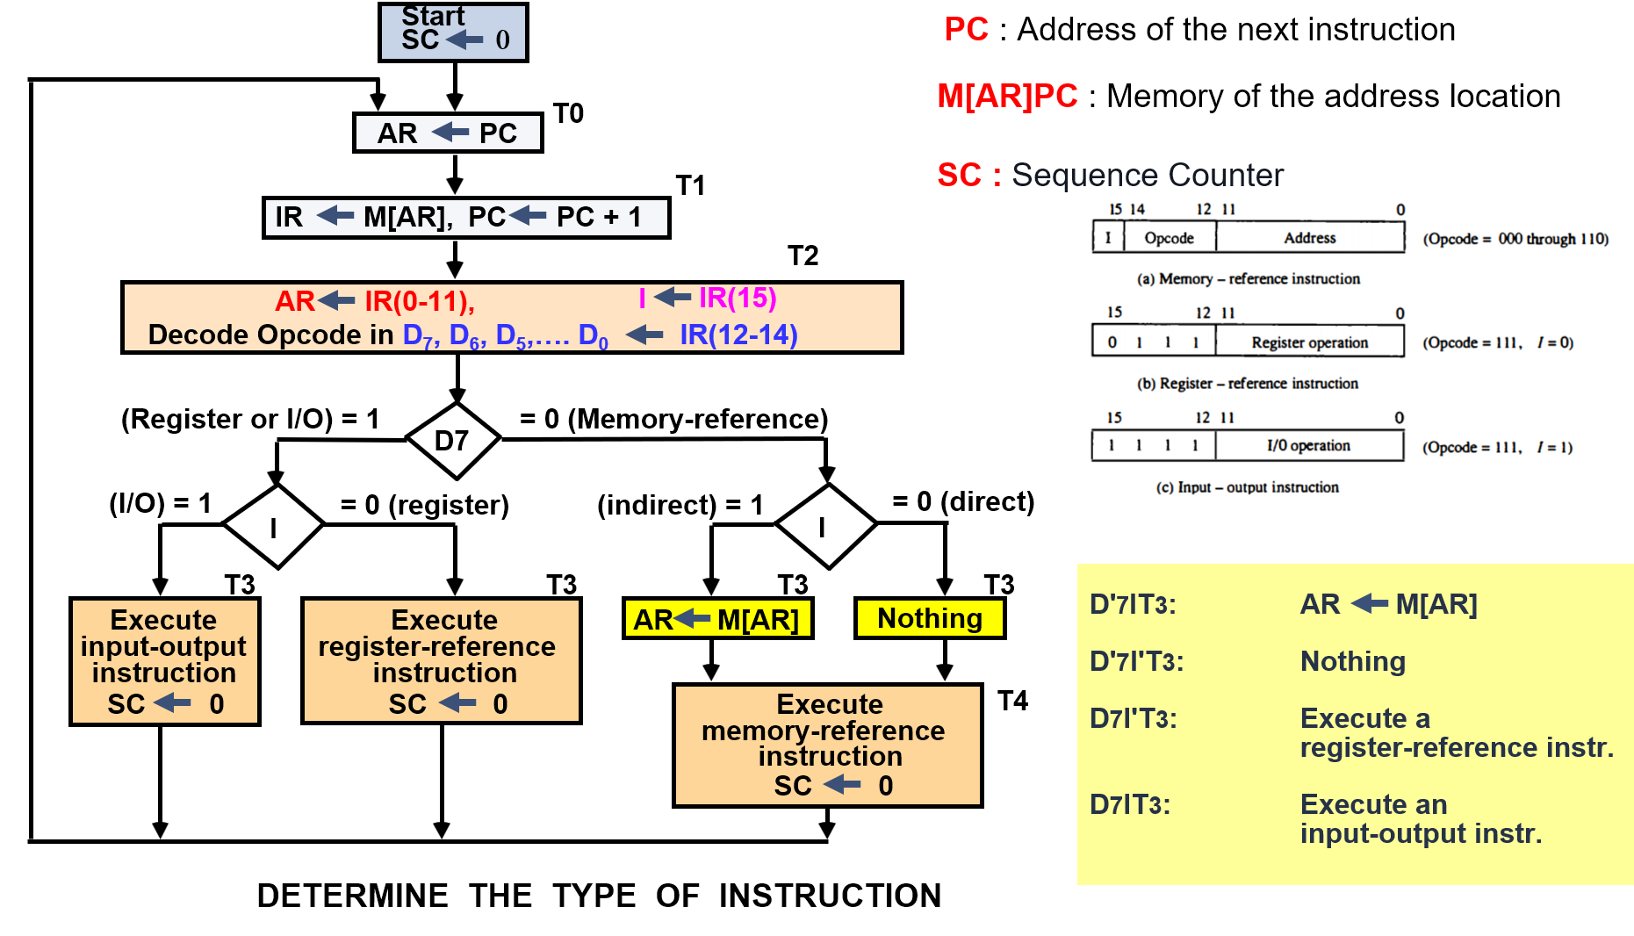

Slide 23

Fetch and Decode
Initially, the program counter PC is loaded with the address of the first instruction in the program
The sequence counter SC is cleared to 0, providing a decoded timing signal T0
The micro operations for the fetch and decode phases can be specified by the following register transfer statements

Slide 24
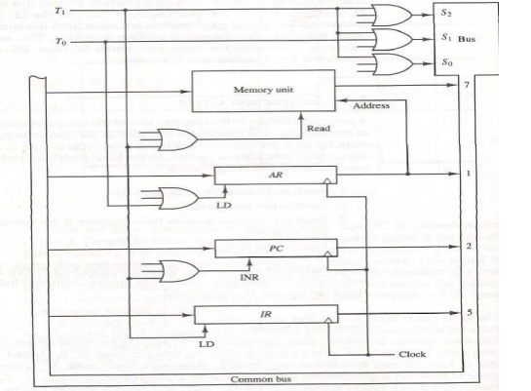

Slide 25
MEMORY REFERENCE INSTRUCTIONS
Symbol
Operation
Decoder
Symbolic Description
AND D₀ AC ← AC ∧ M[AR]
ADD D₁ AC ← AC + M[AR], E ← C_{out}
LDA D₂ AC ← M[AR]
STA D₃ M[AR] ← AC
BUN D₄ PC ← AR
BSA D₅ M[AR] ← PC, PC ← AR + 1
ISZ D₆ M[AR] ← M[AR] + 1, if M[AR] + 1 = 0 then PC ← PC+1
The effective address of the instruction is in AR and was placed there during timing signal T₂ when I = 0, or
during timing signal T₃ when I = 1
Memory cycle is assumed to be short enough to complete in a CPU cycle
The execution of MR instruction starts with T₄
AND to AC
D₀T₄: DR ← M[AR] Read operand
D₀T₅: AC ← AC ∧ DR, SC ← 0 AND with AC
ADD to AC
D₁T₄: DR ← M[AR] Read operand
D₁T₅: AC ← AC + DR, E ← C_{out}, SC ← 0 Add to AC and store carry in E

Slide 26
LDA: Load to AC
D₂T₄: DR ← M[AR]
D₂T₅: AC ← DR, SC ← 0
STA: Store AC
D₃T₄: M[AR] ← AC, SC ← 0
BUN: Branch Unconditionally
D₄T₄: PC ← AR, SC ← 0
BSA: Branch and Save Return Address
M[AR] ← PC, PC ← AR + 1
D₅T₅: PC ← AR, SC ← 0
ISZ: Increment and Skip-if-Zero
D₆T₄: DR ← M[AR]
D₆T₅: DR ← DR + 1
D₆T₄: M[AR] ← DR, if (DR = 0) then (PC ← PC + 1), SC ← 0

Slide 27
FLOWCHART FOR MEMORY REFERENCE INSTRUCTIONS
Memory-reference instruction
AND
ADD
LDA
STA
D T
D T
D T
D T
0
4
1
4
2
4
3
4
DR ← M[AR]
DR ← M[AR]
DR ← M[AR]
M[AR] ← AC
SC ← 0
D T
D T
D T
∧
0
5
1
5
2
5
AC ← AC DR
AC ← AC + DR
AC ← DR
SC ← 0
E ← Cout
SC ← 0
SC ← 0
BUN
BSA
ISZ
D T
D T
D T
4
4
5
4
6
4
PC ← AR
M[AR] ← PC
DR ← M[AR]
SC ← 0
AR ← AR + 1
D T
D T
5
5
6
5
PC ← AR
DR ← DR + 1
SC ← 0
D T
6
6
M[AR] ← DR
If (DR = 0)
then (PC ← PC + 1)
SC ← 0

Slide 28
Input-Output and Interrupt
Input-Output and Interrupt
Instructions and data stored in memory must come from some input device.
Computational results must be transmitted to the user through some output device
To demonstrate the most basic requirements for input and output communication, we will use as an illustration a terminal unit with a keyboard and printer

Slide 29
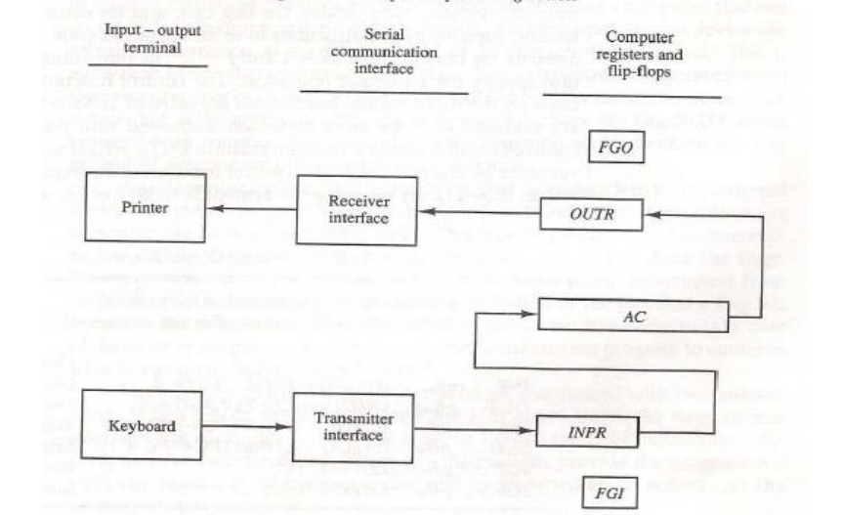
Input-Output Configuration

Slide 30
Input-Output Instructions

Slide 31
FLOWCHART FOR INTERRUPT CYCLE
R = Interrupt flip-flop
Instruction cycle
=0
=1
Interrupt cycle
R
Fetch and decode
Store return address
instructions
in location 0
M[0] ← PC
=0
Execute
IEN
instructions
=1
Branch to location 1
PC ← 1
=1
FGI
=0
=1
IEN ← 0
R ← 0
FGO
=0
R ← 1

Slide 32
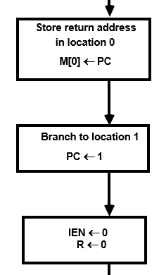
Interrupt cycle
Interrupt cycle
Memory
Before interrupt
After interrupt cycle
0
0
256
1
0
BUN
1120
PC = 1
0
BUN
1120
Main
Main
255
Program
255
Program
PC = 256
256
1120
1120
I/O
I/O
Program
Program
Register Transfer Statements for Interrupt Cycle
R F/F ← 1 if IEN (FGI + FGO)T₀′T₁′T₂′
⇔ T₀′T₁′T₂′ (IEN)(FGI + FGO): R ← 1
The fetch and decode phases of the instruction cycle
must be modified ➔ Replace T₀, T₁, T₂ with R'T₀, R'T₁, R’T₂
The interrupt cycle :
RT₀: AR ← 0, TR ← PC
RT₁: M[AR] ← TR, PC ← 0
RT₂: PC ← PC + 1, IEN ← 0, R ← 0, SC ← 0
1
BUN
0
1
BUN
0

Slide 33
COMPLETE COMPUTER DESCRIPTION Flowchart of Operations
start
SC ← 0, IEN ← 0, R ← 0
=0(Instruction Cycle) =1(Interrupt Cycle)
R
R’T₀
RT₀
AR ← PC
R’T₁
AR ← 0, TR ← PC
RT₁
IR ← M[AR], PC ← PC + 1
M[AR] ← TR, PC ← 0
R’T₂
RT₂
AR ← IR(0~11), I ← IR(15)
D₀...D₇ ← Decode IR(12 ~ 14)
PC ← PC + 1, IEN ← 0
R ← 0, SC ← 0
=1(Register or I/O) =0(Memory Ref)
D₇
=1 (I/O) =0 (Register) =1(Indir) =0(Dir)
I
I
D₇IT₃ D₇I’T₃
D₇’IT3 D₇’I’T3
Execute
I/O
Instruction
Execute
RR
Instruction
AR <- M[AR]
Idle
Execute MR
Instruction
D₇’T4

Slide 34
DESIGN OF BASIC COMPUTER(BC)
Hardware Components of BC
A memory unit : 4096 x 16.
Registers: Flip-Flops(Status):
AR, PC, (12 bit) I, S, E, R, IEN, FGI, and FGO
DR, AC, IR, TR, (16 bit)
OUTR, INPR, (8 bit) and
SC (4 bit)
Decoders: 1) 3x8 Opcode decoder 2) 4x16 timing decoder
Common bus: 16 bits
Control logic gates: Adder and Logic circuit: Connected to AC
Input Controls of the nine registers
Read and Write Controls of memory
Set, Clear, or Complement Controls of the flip-flops
S₂, S₁, S₀ Controls to select a register for the bus
AC, and Adder and Logic circuit

Slide 35
COMPLETE COMPUTER DESCRIPTION Microoperations
Fetch
Decode
Indirect
Interrupt
Memory-Reference
AND
ADD
LDA
STA
BUN
BSA
ISZ
R′T₀:
R′T₁:
R′T₂:
D₇′IT₃:
RT₀:
RT₁:
RT₂:
D₀T₄:
D₀T₅:
D₁T₄:
D₁T₅:
D₂T₄:
D₂T₅:
D₃T₄:
D₄T₄:
D₅T₄:
D₅T₅:
D₆T₄:
D₆T₅:
D₆T₆:
AR ← PC
IR ← M[AR], PC ← PC + 1
D0, ..., D7 ← Decode IR(12 ~ 14),
AR ← IR(0 ~ 11), I ← IR(15)
AR ← M[AR]
R ← 1
AR ← 0, TR ← PC
M[AR] ← TR, PC ← 0
PC ← PC + 1, IEN ← 0, R ← 0, SC ← 0
DR ← M[AR]
AC ← AC ∧ DR, SC ← 0
DR ← M[AR]
AC ← AC + DR, E ← C_{out}, SC ← 0
DR ← M[AR]
AC ← DR, SC ← 0
M[AR] ← AC, SC ← 0
PC ← AR, SC ← 0
M[AR] ← PC, AR ← AR + 1
PC ← AR, SC ← 0
DR ← M[AR]
DR ← DR + 1
M[AR] ← DR, if(DR=0) then (PC ← PC + 1),
SC ← 0
T₀′T₁′T₂′(IEN)(FGI + FGO):

Slide 36
Register-Reference
CLA
CLE
CMA
CME
CIR
CIL
INC
SPA
SNA
SZA
SZE
HLT
Input-Output
INP
OUT
SKI
SKO
ION
IOF
D₇I′T₃ = r
IR(i) = B_{i}
r:
rB₁₁:
rB₁₀:
rB₉:
rB₈:
rB₇:
rB₆:
rB₅:
rB₄:
rB₃:
rB₂:
rB₁:
rB₀:
D₇IT₃ = p
IR(i) = B_{i}
p:
pB₁₁:
pB₁₀:
pB₉:
pB₈:
pB₇:
pB₆:
(Common to all register-reference instr)
(i = 0,1,2, ..., 11)
SC ← 0
AC ← 0
E ← 0
AC ← AC′
E ← E′
AC ← shr AC, AC(15) ← E, E ← AC(0)
AC ← shl AC, AC(0) ← E, E ← AC(15)
AC ← AC + 1
If(AC(15) =0) then (PC ← PC + 1)
If(AC(15) =1) then (PC ← PC + 1)
If(AC = 0) then (PC ← PC + 1)
If(E=0) then (PC ← PC + 1)
S ← 0
(Common to all input-output instructions)
(i = 6,7,8,9,10,11)
SC ← 0
AC(0-7) ← INPR, FGI ← 0
OUTR ← AC(0-7), FGO ← 0
If(FGI=1) then (PC ← PC + 1)
If(FGO=1) then (PC ← PC + 1)
IEN ← 1
IEN ← 0

Slide 37
CONTROL OF REGISTERS AND MEMORY
Address Register; AR
Scan all of the register transfer statements that change the content of AR:
12
12
R’T₀: AR ← PC LD(AR)
R’T₂: AR ← IR(0-11) LD(AR)
D’₇IT₃: AR ← M[AR] LD(AR)
RT₀: AR ← 0 CLR(AR)
D₅T₄: AR ← AR + 1 INR(AR)
From bus
To bus
D'
AR
7
I
LD
Clock
T
3
T
INR
2
CLR
R
LD(AR) = R'T₀ + R'T₂ + D'₇IT₃
CLR(AR) = RT₀
INR(AR) = D₅T₄
T
0
D
T
4

Slide 38
CONTROL OF FLAGS
IEN: Interrupt Enable Flag
pB₇: IEN <− 1 (I/O Instruction)
pB₆: IEN <− 0 (I/O Instruction)
RT₂: IEN <− 0 (Interrupt)
p = D₇IT₃ (Input/Output Instruction)
D
7
p
I
J
Q
IEN
B
T₃
7
B
6
K
R
T
2

Slide 39
CONTROL OF COMMON BUS
x1
x2
S
2
Multiplexer
x3
Encoder
x4
S
bus select
1
x5
inputs
x6
S
0
x7
x1 x2 x3 x4 x5 x6 x7
S2 S1 S0
selected
register
0 0 0 0 0 0 0 0 0 0 none
1 0 0 0 0 0 0 0 0 1 AR
0 1 0 0 0 0 0 0 1 0 PC
0 0 1 0 0 0 0 0 1 1 DR
0 0 0 1 0 0 0 1 0 0 AC
0 0 0 0 1 0 0 1 0 1 IR
0 0 0 0 0 1 0 1 1 0 TR
0 0 0 0 0 0 1 1 1 1 Memory
For AR
D₄T₄: PC <− AR
D₅T₅: PC <− AR
x1 = D₄T₄ + D₅T₅

Slide 40
DESIGN OF ACCUMULATOR LOGIC
16
Circuits associated with AC
16
Adder and
16
16
From DR
logic
AC
8
circuit
To bus
From INPR
LD
INR
CLR
Clock
Control
gates
All the statements that change the content of AC
D₀T₅: AC <− AC ∧ DR AND with DR
D₁T₅: AC <− AC + DR Add with DR
D₂T₅: AC <− DR Transfer from DR
pB₁₁: AC(0-7) <− INPR Transfer from INPR
rB₉: AC <− AC′ Complement
rB₇ : AC <− shr AC, AC(15) <− E Shift right
rB₆ : AC <− shl AC, AC(0) <− E Shift left
rB₁₁ : AC <− 0 Clear
rB₅ : AC <− AC + 1 Increment

